Slide 1

Welcome to the
Getting Started With Your BootCamp
The session will start shortly…
Questions? Drop them in the chat. We'll have dedicated moderators answering questions.

Slide 2

Cyber Security Session Housekeeping
The use of disrespectful language is prohibited in the questions, this is a supportive, learning environment for all - please engage accordingly. (Fundamental British Values: Mutual Respect and Tolerance)
No question is daft or silly - ask them!
There are Q&A sessions midway and at the end of the session, should you wish to ask any follow-up questions. Moderators are going to be answering questions as the session progresses as well.
If you have any questions outside of this lecture, or that are not answered during this lecture, please do submit these for upcoming Academic Sessions. You can submit these questions here: Questions

Slide 3
Cyber Security Session Housekeeping cont.
For all non-academic questions, please submit a query: www.hyperiondev.com/support
We would love your feedback on lectures: Feedback on Lectures
Find all the lecture content in you Lecture Backpack on GitHub.
If you are hearing impaired, please kindly enable captions on Google chrome/Microsoft Edge via the accessibility settings.

Slide 4


Slide 5

Learning Objectives & Outcomes
Explain the purpose of pseudo code in problem-solving and program design.
Define Python as a high level language.
Create a program that handles input and output using Python.
Create and use variables in code.
Identify different data types.
Implement different data types in code.
Notes:
Mention moderators and Questions tab. Our agenda includes an introduction to CoGrammar, details about student success support, graduation criteria, guided learning hours, learning tools and platforms, an overview of the Skills Bootcamp, and career services.

Slide 6


CyberSecurity
April 2024
Notes:
Welcome to the Grammar Skills Bootcamp Orientation for November 2023. Today, we will cover several important aspects of this program to ensure you have all the information needed for a successful learning experience.

Slide 7
Installation guidance.
Before we get going, please consult the ‘Additional Reading - Installation, Sharing and Collaboration’ guide that accompanies this task.
The guide provides a detailed instruction on setting up (On macOs, linux or windows):
Visual Studio Code
Python
Notes:
Mention moderators and Questions tab. Our agenda includes an introduction to CoGrammar, details about student success support, graduation criteria, guided learning hours, learning tools and platforms, an overview of the Skills Bootcamp, and career services.

Slide 8
What is Pseudo Code?
Pseudo code is a simple, plain-English way of describing steps to solve a problem.
In programming, it is not actual code but rather a tool to plan the logic of a program.
Helps programmers think through problems and structure solutions before coding.
Notes:
Mention moderators and Questions tab. Our agenda includes an introduction to CoGrammar, details about student success support, graduation criteria, guided learning hours, learning tools and platforms, an overview of the Skills Bootcamp, and career services.

Slide 9
Example: Instructions for making a sandwich
Start
Take two slices of bread
Spread butter on both slices of bread
Add filling of choice (e.g. Ham/Cheese)
Close the sandwich with both slices
End.
Notes:
Mention moderators and Questions tab. Our agenda includes an introduction to CoGrammar, details about student success support, graduation criteria, guided learning hours, learning tools and platforms, an overview of the Skills Bootcamp, and career services.

Slide 10
Introduction to Python
Python is a high-level, interpreted programming language known for its simplicity and readability.
Widely used for:
Web development
Data analysis
Machine learning
Automation and more.
Notes:
Mention moderators and Questions tab. Our agenda includes an introduction to CoGrammar, details about student success support, graduation criteria, guided learning hours, learning tools and platforms, an overview of the Skills Bootcamp, and career services.

Slide 11
Writing your first computer program with python.
Programs are executable files that perform the instructions given by the programmer.
Since there are variety of languages, in order to write a python script or code, you need to create a python file.
We can name the file with any user defined name and have the .py extension after it.
The file created should live inside a known folder in your laptop.
Notes:
Mention moderators and Questions tab. Our agenda includes an introduction to CoGrammar, details about student success support, graduation criteria, guided learning hours, learning tools and platforms, an overview of the Skills Bootcamp, and career services.

Slide 12
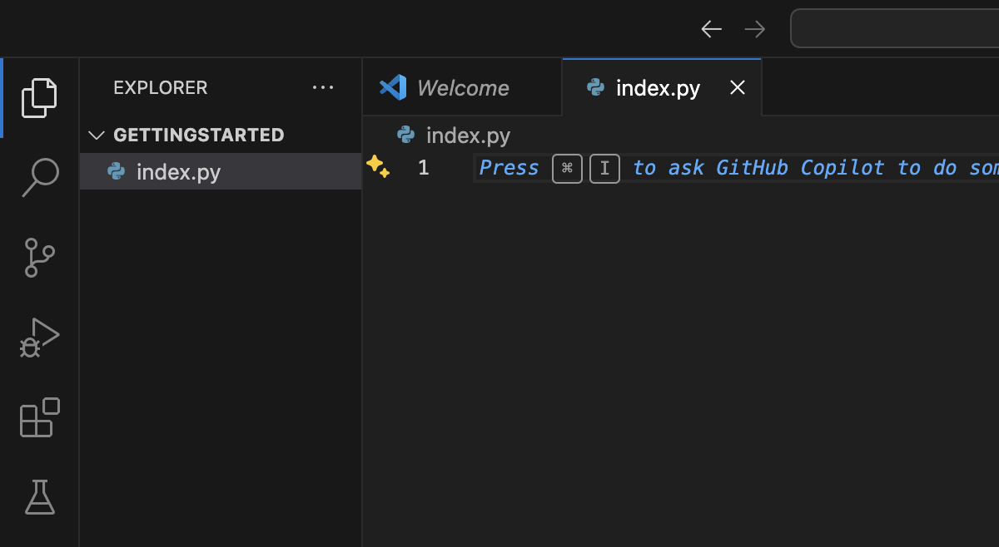
Writing your first computer program with python.
Notes:
Mention moderators and Questions tab. Our agenda includes an introduction to CoGrammar, details about student success support, graduation criteria, guided learning hours, learning tools and platforms, an overview of the Skills Bootcamp, and career services.

Slide 13
Writing your first computer program with python.
The print() function:
For our first program, we may want to display or output information to the user. The most common way to view program output is to use the print function.
The print function takes in the data to display as an argument.
Example: print(“Hello World”)
To run this program, you need to open your terminal and write in the command python followed by the name of the file created with the script.
Notes:
Mention moderators and Questions tab. Our agenda includes an introduction to CoGrammar, details about student success support, graduation criteria, guided learning hours, learning tools and platforms, an overview of the Skills Bootcamp, and career services.

Slide 14
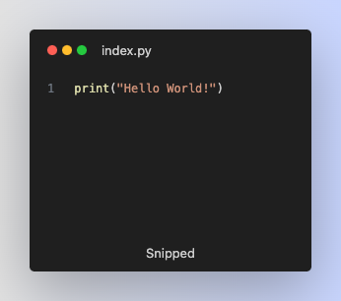
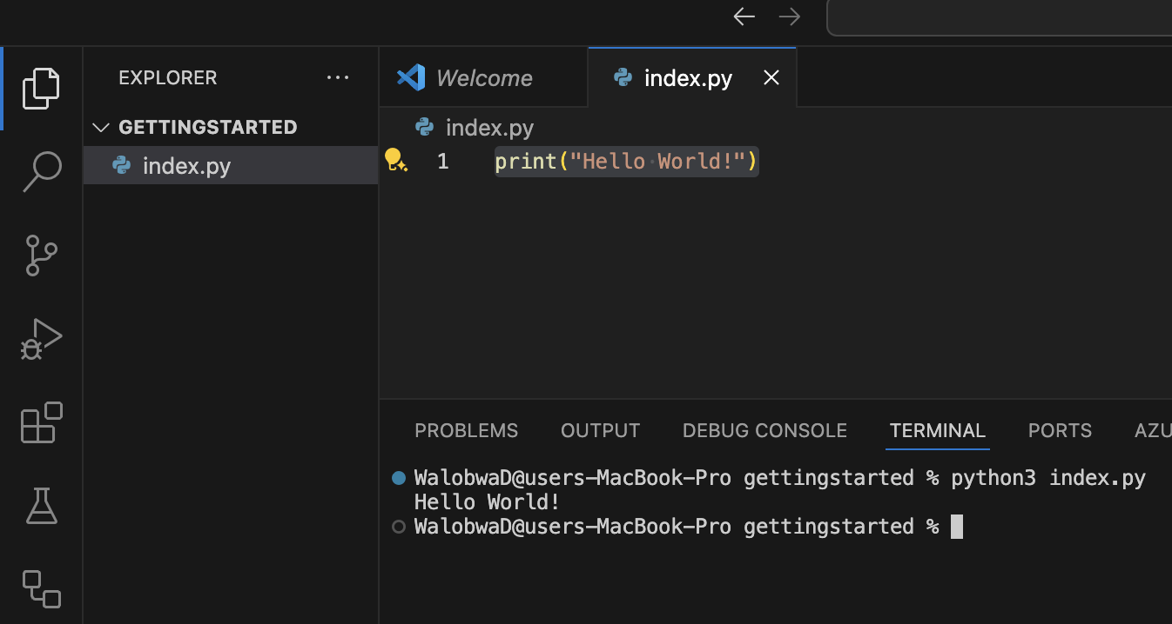
Running your first python script.
Notes:
Mention moderators and Questions tab. Our agenda includes an introduction to CoGrammar, details about student success support, graduation criteria, guided learning hours, learning tools and platforms, an overview of the Skills Bootcamp, and career services.

Slide 15
Variables
A variable is a named storage location in a computer’s memory that holds a value that can be changed or updated as the program runs.
In python, we use the following format to create a variable and design a value to it.
variable_name = value_you_want_to_store
Notes:
Mention moderators and Questions tab. Our agenda includes an introduction to CoGrammar, details about student success support, graduation criteria, guided learning hours, learning tools and platforms, an overview of the Skills Bootcamp, and career services.

Slide 16
How to get input.
Sometimes you might want the user to enter data that will be used by your program, to do this, you need to use the input method.
name = input("Enter your name: ")
The variable name stores what the user entered into the box as a string.
Notes:
Mention moderators and Questions tab. Our agenda includes an introduction to CoGrammar, details about student success support, graduation criteria, guided learning hours, learning tools and platforms, an overview of the Skills Bootcamp, and career services.

Slide 17
Questions and
Answers

Slide 18

Thank you for attending

